Slide 1
Weekly highlights

Slide 2
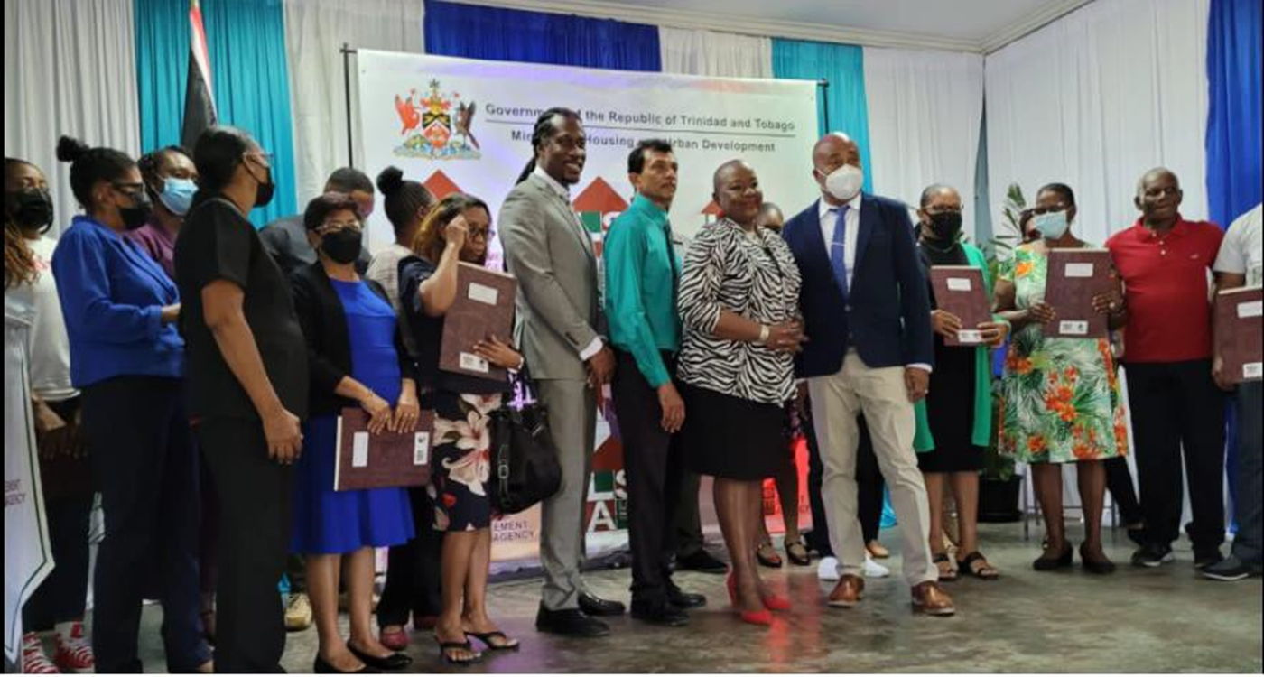
On September 6, 2022, the Ministry of Housing and Urban Development, through its agency, the Land Settlement Agency distributed 25 Deeds of Lease to beneficiaries of the Government Aided Self-Help Housing Programme.

Slide 3
On September 16, 2022, the East Port of Spain Development Company - an Agency of the Ministry of Housing and Urban Development was out in full force driving a beach clean up at Cedros.

Slide 4
On September 19, 2022, the Ministry of Housing and Urban Development through its Agency, the HDC, turned the Sod for 58 Rental Units at
Beetham Gardens.

Slide 5
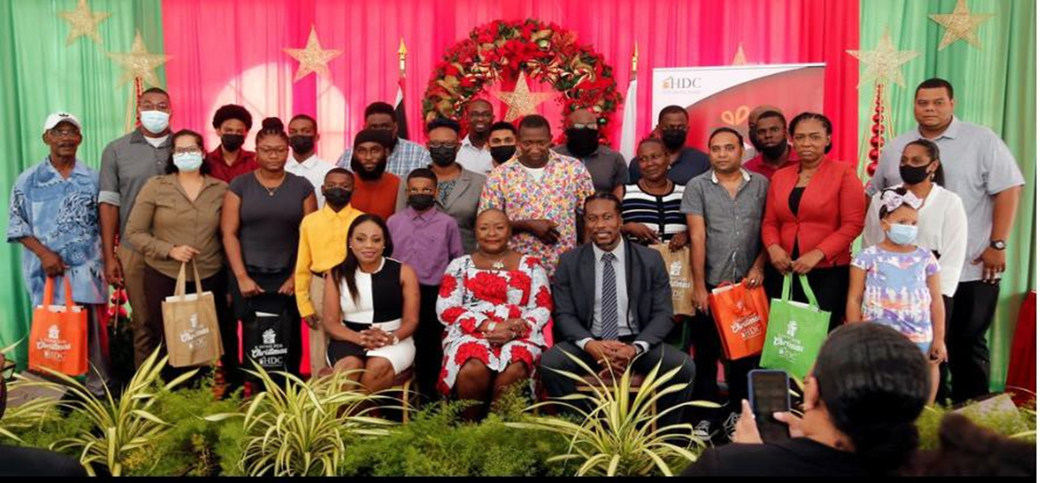
On September 20, 2022, the Ministry of Housing and Urban Development through the HDC’s- A Home for Christmas programme distributed keys to 45 new homeowners at
Heron Court, Malabar.
.

Slide 6
Did you know that the Housing Programme Facilitation and Implementation Unit of the Ministry administers a non-refundable Home Improvement Grant of $15,000.00 to low income households, to assist with basic repairs and upgrades to enhance their living conditions?
Call us at 623-4663 ext. 2054, or visit www.housing.gov.tt for further details.
@housingtt
www.housing.gov.tt
@housing_tt

Slide 7
...and those were this week’s highlights!
@housingtt
www.housing.gov.tt
@housing_tt

